Slide 1
The Stories They Tell: My Interactions with the Business and How Storytelling Creates Leaders
Ben Barnard
Notes:
Hello, I am Ben Barnard, a data scientist at Well Fargo. I live in Fort Worth, Texas. My interests include communicating to leaders and consulting across the business. This leads us to this presentation. ”The Stories They Tell: My Interactions with the Business and How Storytelling Creates Leaders.”

Slide 2
"It was the best of times, it was the worst of times, it was the age of wisdom, it was the age of foolishness, it was the epoch of belief, it was the epoch of incredulity, it was the season of Light, it was the season of Darkness, it was the spring of hope, it was the winter of despair, we had everything before us, we had nothing before us, we were all going direct to Heaven, we were all going direct the other way—in short, the period was so far like the present period, that some of its noisiest authorities insisted on its being received, for good or for evil, in the superlative degree of comparison only."
Notes:
"It was the best of times, it was the worst of times, it was the age of wisdom, it was the age of foolishness, it was the epoch of belief, it was the epoch of incredulity, it was the season of Light, it was the season of Darkness, it was the spring of hope, it was the winter of despair, we had everything before us, we had nothing before us, we were all going direct to Heaven, we were all going direct the other way—in short, the period was so far like the present period, that some of its noisiest authorities insisted on its being received, for good or for evil, in the superlative degree of comparison only.” Are we in contrasting times of extremes? What can make the difference between the best of times and the worst of times? First and foremost, how we communicate or the stories we tell define how our analytics are used, whether we create champions, or if we just become a story they tell. In this presentation I will tell some of my own stories.

Slide 3
Who are you?
Citizen Data Scientist
Academic Professor
20-year veteran
CEO
Research Scientist
Notes:
I don’t think it matters who you are or what you background is as professionals we must quantify uncertainty and do it in a way that encourages champions. I like to use visualizations and even comics to tell stories to get buy in and partners in data science.

Slide 4
It was a pleasure to p-value.
Notes:
It was a pleasure to p-value. We have all been there, and at one time I was probably the worst offender. Its easy to p-value when everything is significance and significance can be whatever you want. I was consulting for the university I was working for and regularly I had research come to me asking about the significance of their tests and what it meant. The first thing I would ask them is “You tell me what it means. You defined what is meaningful in the test.” Let's just say I got a funny look after that and walked out of my office. I didn’t see him again until he found out I was doing power analyses with one of his colleagues.

Slide 5
Power Analysis
Determine:
Sample size
Type I error
Type II error
Effect size
Tie the business need with the statistical test
In a world we made up why don’t we set values to our benefit
Notes:
I am glad my salary wasn’t directly tied to my consulting work. This researcher came back asking why I was providing his colleague all these meaningful analyses. My response was that in hypothesis testing we create a world that has meaning. If we can not tie the world of the null back to our reality the meaningful world, we created has no meaning in our own. I got another perplexed look. I elaborated that we create a nonexistent world of the null hypothesis by using assumptions, and then we design the way in which it has meaning. If your test isn’t designed with practical significance, it will never be significant. A p-value is just a number its just math and doesn’t have meaning until we make it meaningful. Alpha doesn’t always have to be 0.05 and sometimes the sample size is determined for us. The hypothesis test should measure our decision not the framework we think we are forced into. In the end the researcher started looking at his problems a different way and overloaded me with power analyses.

Slide 6
All good predictive models are alike; each bad predictive model is bad in its own way.
Notes:
All good predictive models are alike; each bad predictive model is bad in its own way. I find there are a lot of non-analytics leaders think all models are good and they can be used. Why do we need to check assumptions? Why do we need to plot the data? I had a leader come to my office wanting me to figure out why their linear model on excel was not working very well. They hadn’t run any diagnostics on their data or plotted it. I pulled out Anscombs’s Quartet.

Slide 7
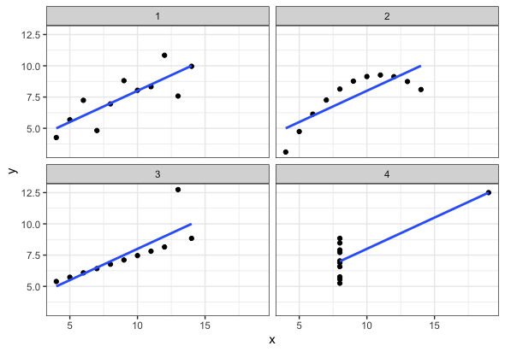
Anscombe’s Quartet
Mean of x and y
Sample variance of x and y
Correlation between x and y
Linear regression line
Coefficient of determination
Notes:
Her we have four data sets and when we apply linear regression, we get the same mean, variance, correlation, regression line, and coefficient of determination. Only one of the cases is the line truly appropriate. I sold the leader on looking at the data and running diagnostics. I ended up getting a week of sleepless nights doing an analysis for that leader. There are a few more datasets like this that also create interesting results.

Slide 8
It is a truth universally acknowledged, that a business in possession of data, must be in want of a data scientist.

Slide 9
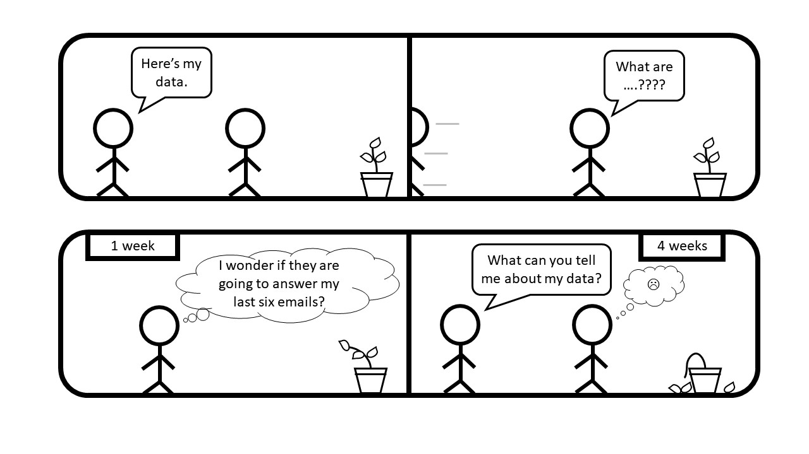
Collaborative Analytics
Analytics isn’t a waterfall, but agile and dynamic
If you are wearing a bulletproof vest something is wrong
You are the expert

